Slide 1
ER MODEL
-Done By
Sharon Sam Simpson

Slide 2
The Entity Relationship Model
The ER model stands for an Entity-Relationship model.
The ER model was introduced and formalized by Peter Chen in 1976.
It is a model to represent the database structure in different entities with their attributes and relationships between the entities for a specified system.

Slide 3
Facts about ER Model
It is a blueprint of a database
It is attractive and user-friendly graphical notation
Helps to identifies the entities and relationships in that system

Slide 4
The ER Diagram
An Entity–relationship model (ER model) describes the structure of a database with the help of a diagram, which is known as Entity Relationship Diagram (ER Diagram).

Slide 5
Components of E-R Diagram
Entity types
Attribute types
Relationship types

Slide 6
Entity Types
Entity:
An entity is an object or component of data.
Represented as rectangle.
Weak Entity:
It is an entity that cannot be uniquely identified by its own attributes and relies on the relationship with other entity.
Represented by a double rectangle.

Slide 7
Attribute Types
Attribute:
An attribute describes the property of an entity.
Represented as Oval.
Types:
Key attribute
Composite attribute
Multivalued attribute
Derived attribute

Slide 8
Relationship Types
Cardinality:
Defines the numerical attributes of the relationship between two entities or entity sets.
A relationship is represented by diamond shape.
Types of cardinal relationships:
One to One
One to Many
Many to One
Many to Many

Slide 9
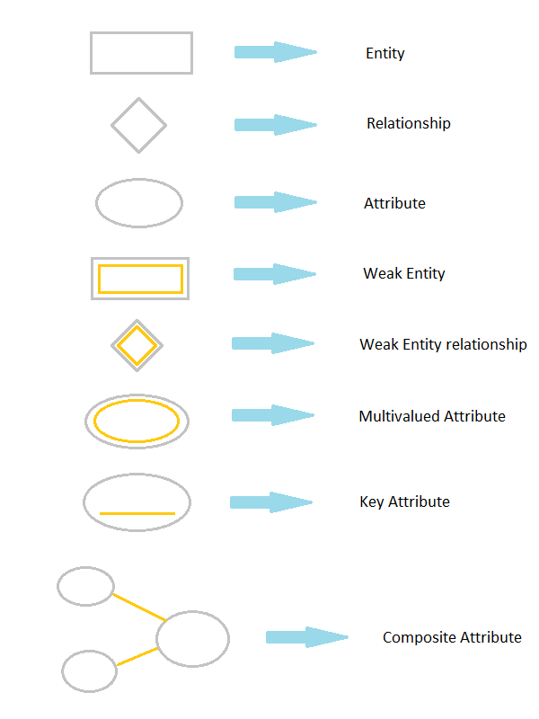
ER Diagram
Symbols

Slide 10
Steps to Create an E-R Diagram
Entity and Attributes Identification
Identify Relationships and Cardinalities
Create ERD

Slide 11
